Slide 1

Presentation on Agile Manifesto
-System Analysis & Design
CONTENTS
Introduction to Agile Manifesto
Values of Agile
12 Principles of Agile
Agile Methodologies
Differences between Agile & Waterfall Model
Pros & Cons of Agile
When Agile is appropriate
Presented By :
Achyut Chapagain
Image Source: www.unsplash.com

Slide 2
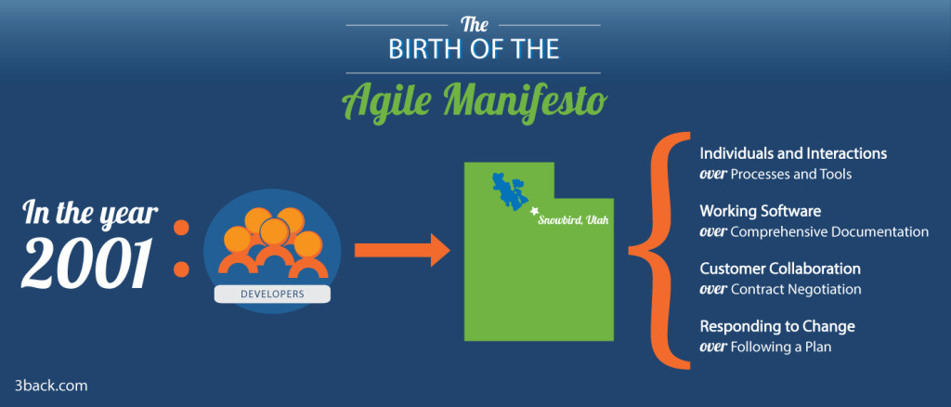
Introduction to Agile Manifesto
6/12/2021
Source: www.3back.com

Slide 3
12 Principals of Agile Manifesto
Customer satisfaction through early and continuous delivery of useful software
Welcome changing requirements, even late in development
Deliver working software frequently
Close, daily cooperation between business people and developers
Projects are build around motivated individuals, who should be trusted
Face-to-face conversation is the best form of communication
Working software is the primary measure of progress
Sustainable development, able to maintain a constant pace
Excellence through reflection (design)
Simplicity--the art of maximizing the amount of work not done--is essential
Self organizing teams
Regular adaptation to changing circumstance
2
Source: www.linkedin.com

Slide 4
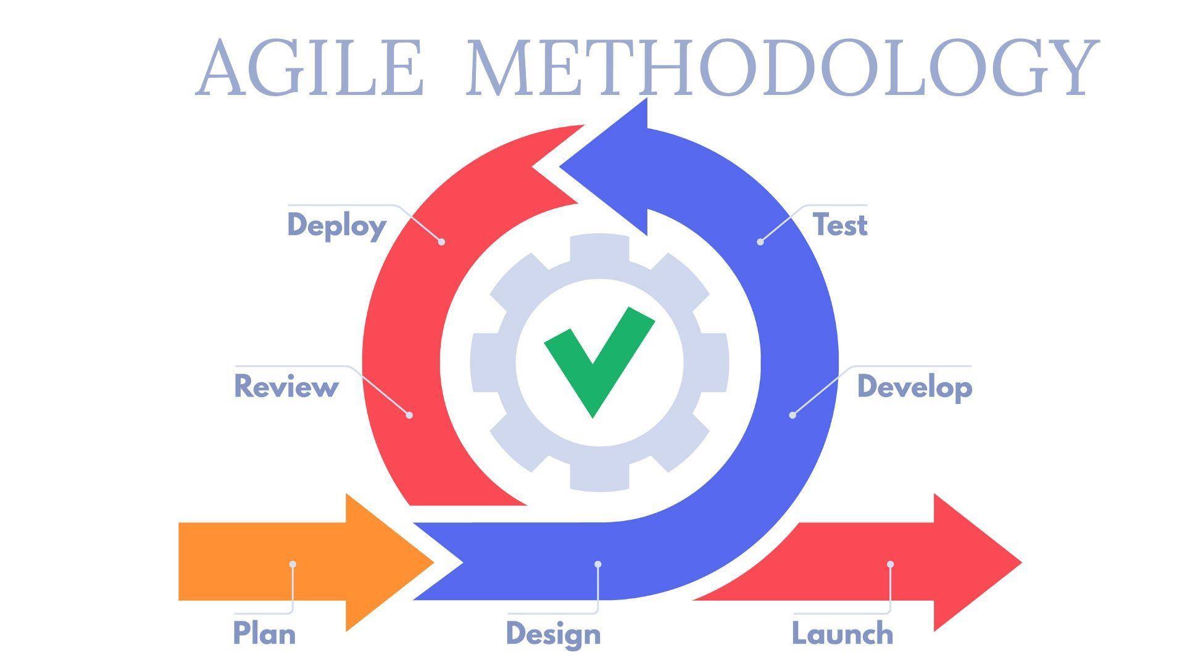
Agile Methodologies
6/12/2021
Source: www.planview.com

Slide 5
Types of Agile Methodologies
Scrum
Extreme Programming (XP)
Lean Software Development
Kanban
Crystal
Feature-Driven Development (FDD)
Dynamic Systems Development Method (DSDM)
6/12/2021
Source: www.planview.com

Slide 6
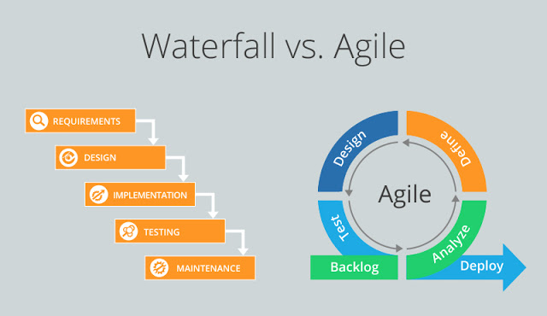
Difference between Agile and Waterfall Model
6/12/2021
Source: www.raafay-awan.blogspot.com

Slide 7
Difference between Agile and Waterfall Model
Basis | Agile Model | Waterfall Model
Work Process | Project management splits the product development process into multiple cycles. | There is only one development cycle. Projects isnot split into multiple cycles
Flexibility | It can handle changing customer requirements with ease | It can’t handle changing project requirements.
Testing Process | The project is reviewed and tested after each phase | Testing is done only once in the entire development phase
Teams | Team members are self-sufficient and cross-functional, while there’s a product owner and project manager guiding the team | Team members have well defined roles and work on what they’re asked to do
Customers Involvement | It facilatates customer feedback at all levels | Clients are involved in the early stages of the project and when the final product is completed
6/12/2021
Source: www.clickup.com

Slide 8
Pros & Cons of Agile
PROS
Rapid Delivery
Continuous Testing
Flexible Change management
Immediate feedback
CONS
Lack of Documentation
Lack of clarity
Advanced skills needed
Insufficient Training
7
Source: www.dcsl.com

Slide 9
When Agile is Appropriate
If senior management support agile processes
Agile works best for new projects, though that doesn’t necessarily mean all new projects should go straight to agile
If you need your project in short time and quality isnot important.
If you have a team of independent thinkers.
If you are working in an industry that quickly changes
8
Source: www.lgoskills.com

Slide 10
THANK YOU!!
Source:
https://www.linkedin.com/pulse/12-agile-manifesto-principles-simply-explained-jacob-aliet-ondiek
https://clickup.com/blog/agile/agile-vs-waterfall/
https://www.edrawsoft.com/agile-vs-waterfall.html
https://3back.com/infographic/agile-manifesto/
https://www.planview.com/resources/guide/agile-methodologies-a-beginners-guide/
https://www.tricentis.com/blog/agile-methodology-guide-agile-testing/
https://www.qualium-systems.com/blog/business/the-pros-and-cons-of-agile-methodologies/
https://www.artofteamwork.com/the-pros-and-cons-of-agile/
https://www.dcsl.com/pros-and-cons-of-the-agile-approach/
https://brandongaille.com/8-pros-and-cons-of-agile-project-management/
https://www.projectmanagementplanet.com/is-agile-always-appropriate/
https://www.goskills.com/Project-Management/Resources/When-to-use-agile-project-management

